Slide 1
VS CODE –MYSQL CONNECTION

Slide 2
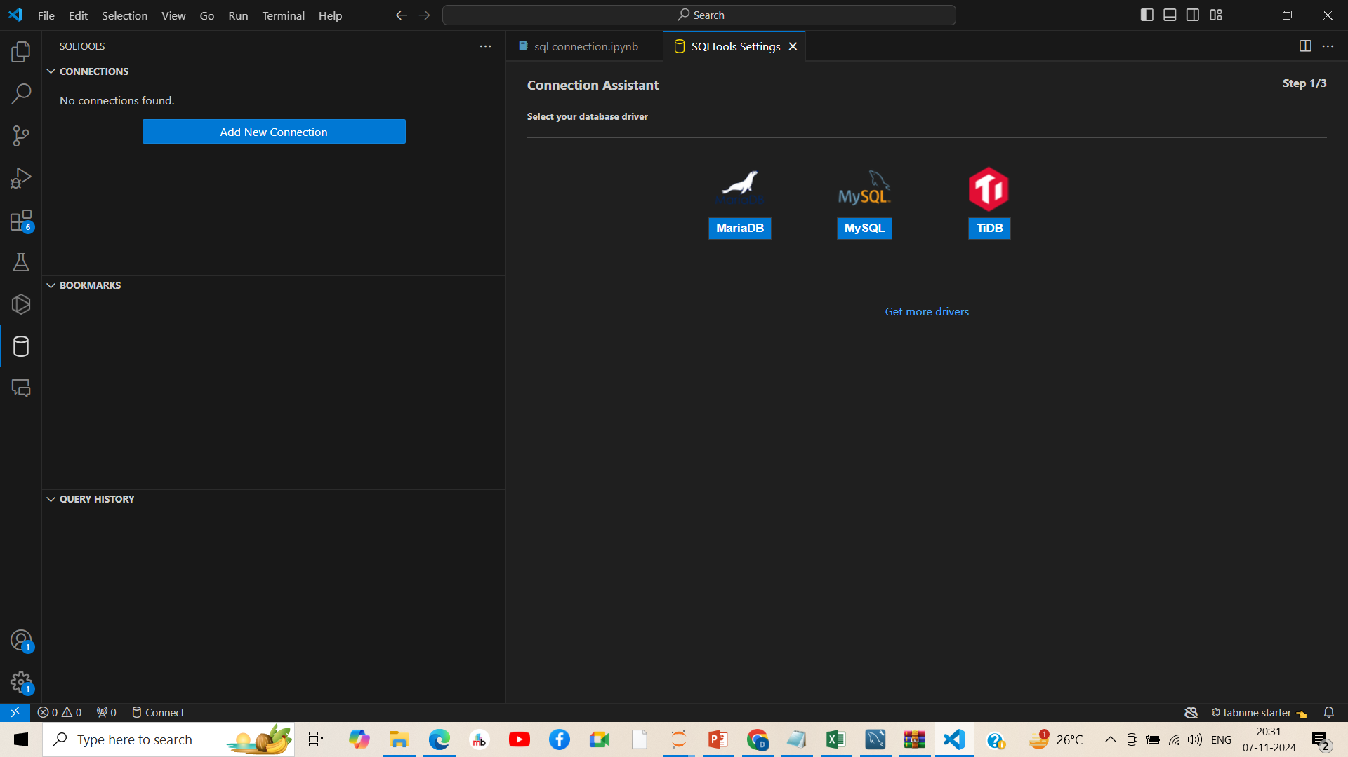

Slide 3
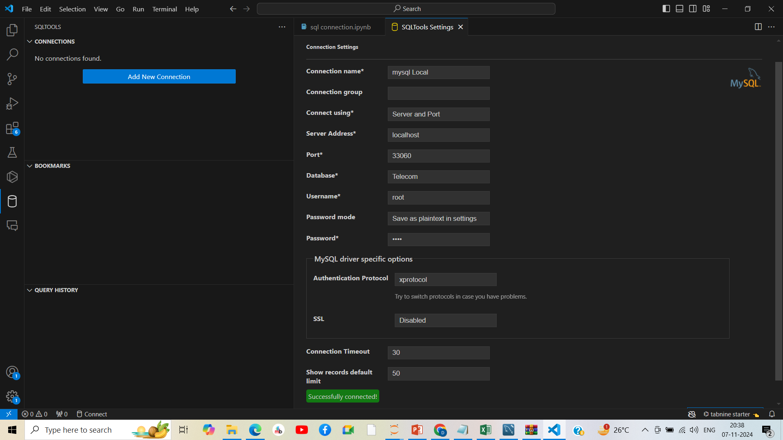

Slide 4
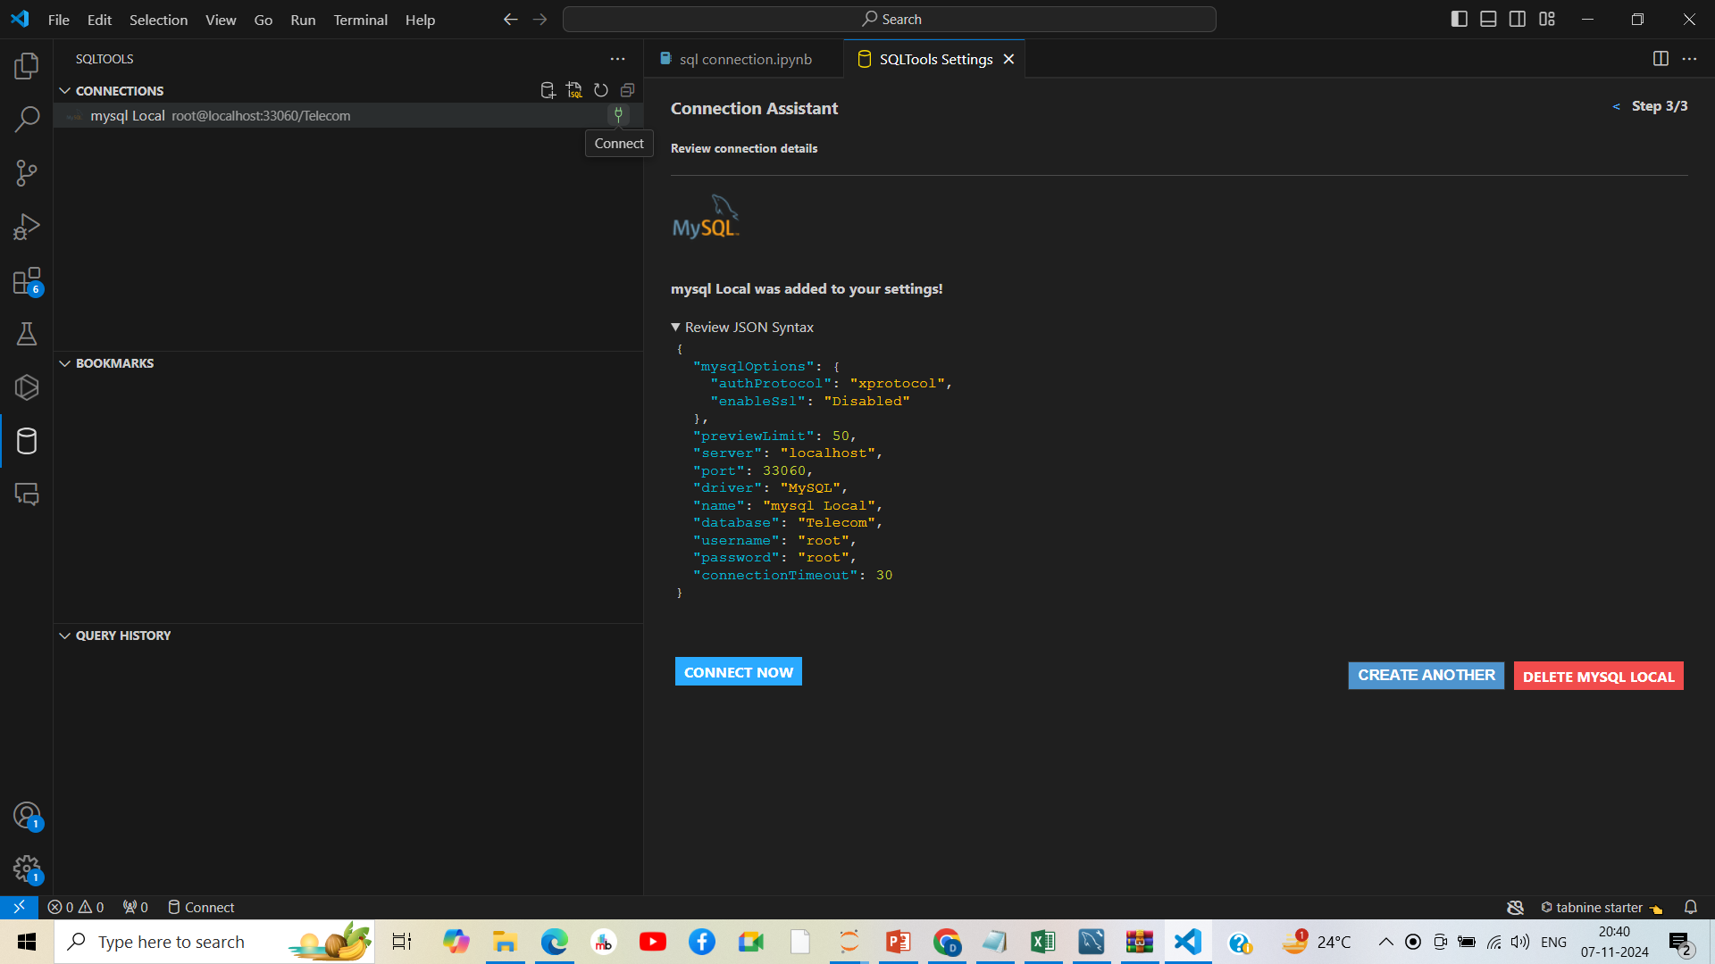

Slide 5
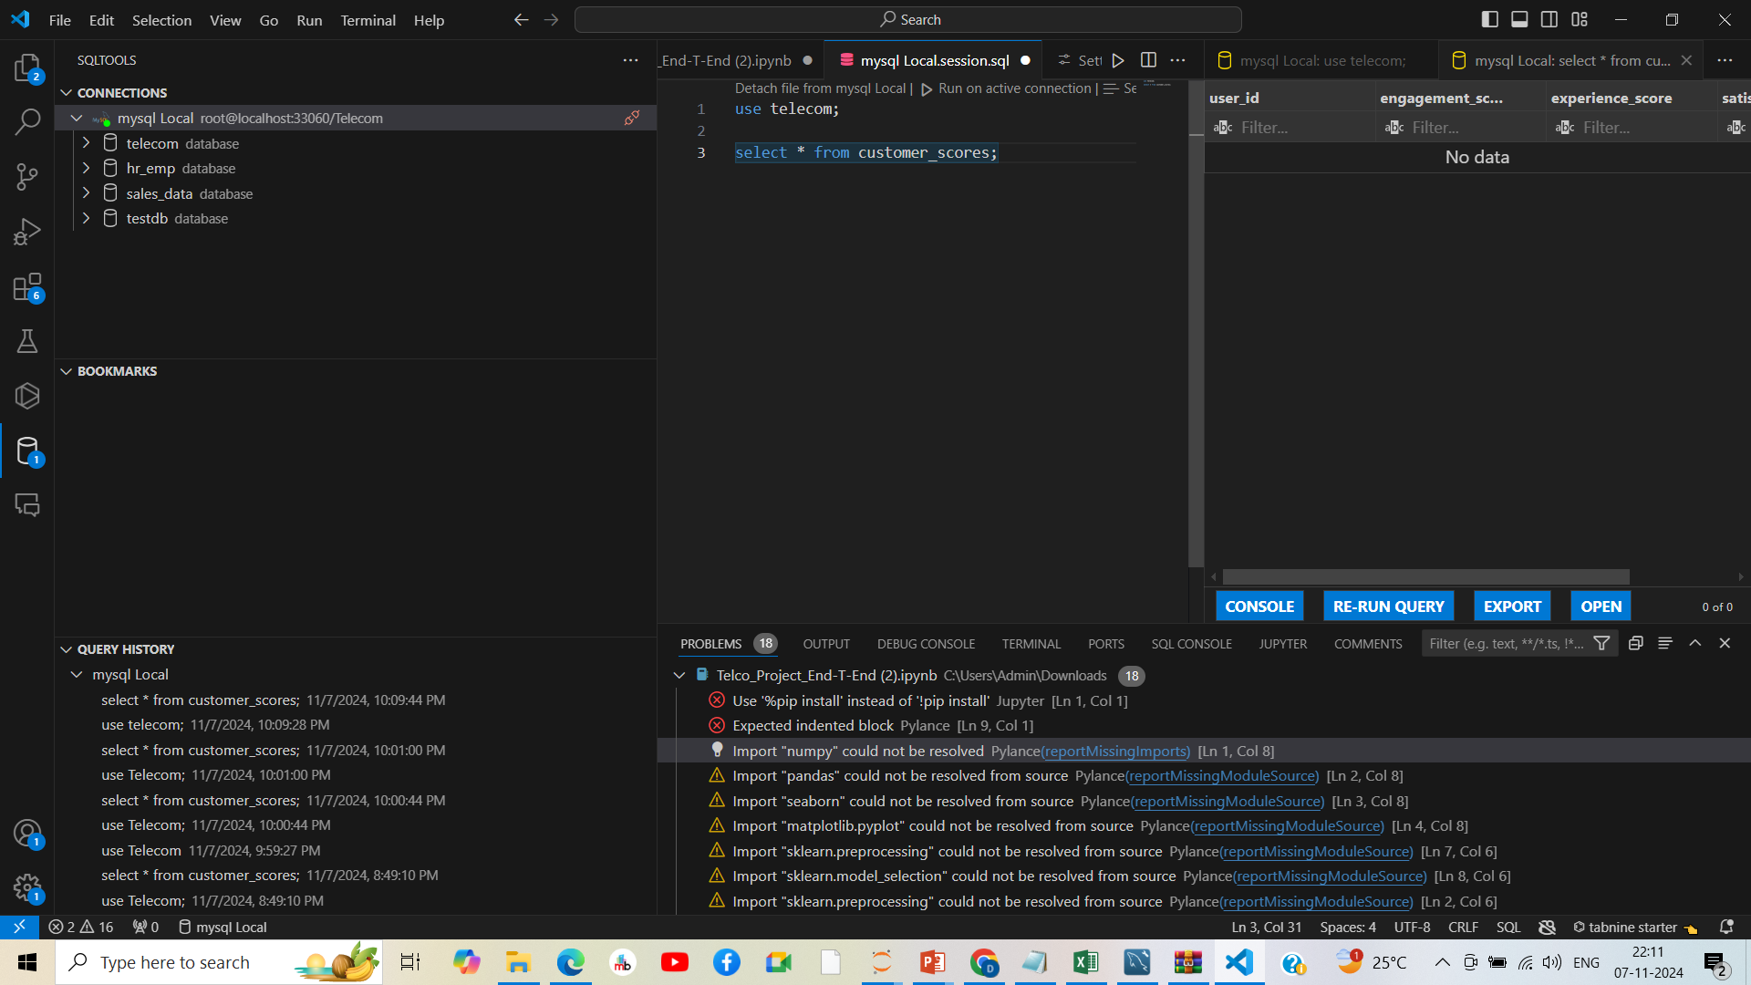
MySql screen on VSCODE with Names of Data Bases

Slide 6
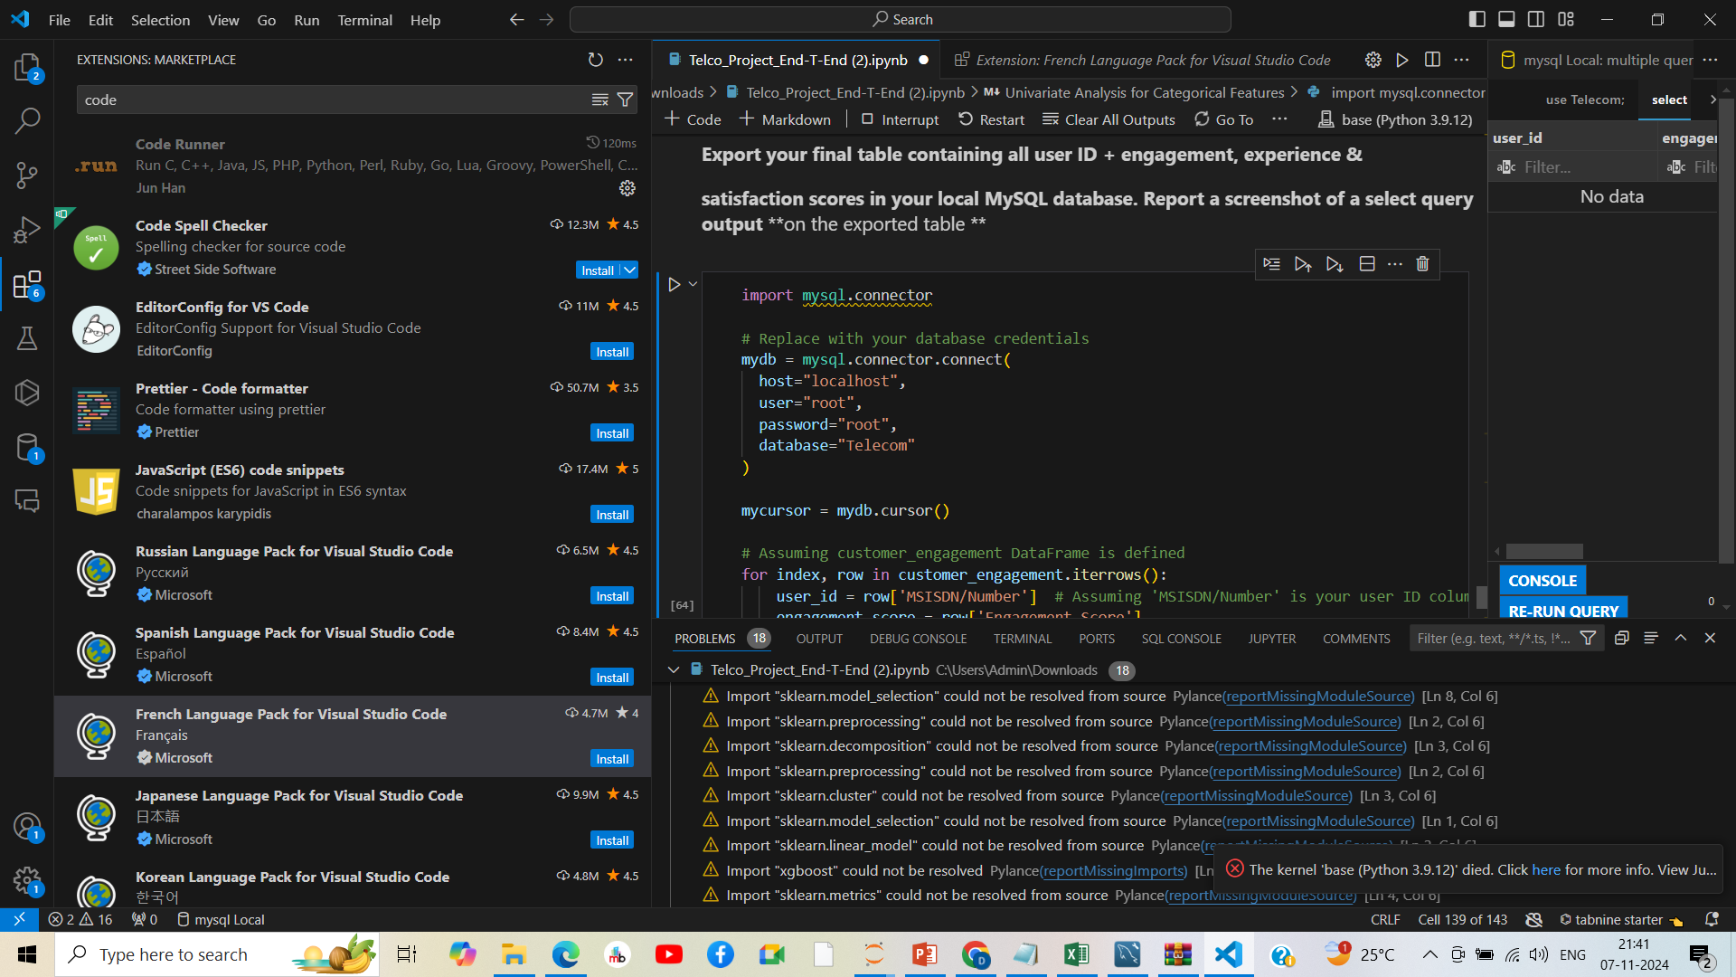
Same issue of Jupyter exists on VSCODE -Kernel Died

Slide 7
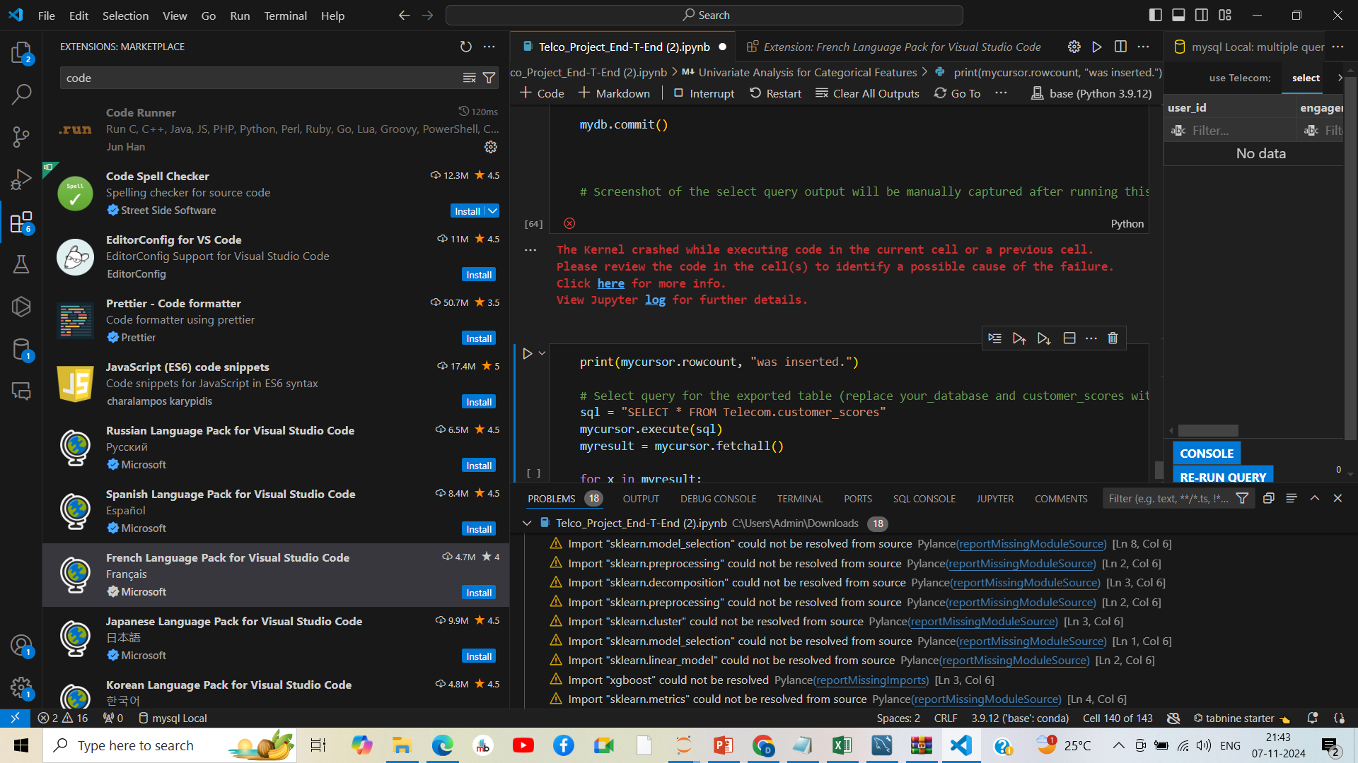
Same issue of Jupyter exists on VSCODE -Kernel Died

